Slide 1
Firewalls
UBNetDef, Fall 2021
Week 3
Lead Presenter:
Alec Duffy

Slide 2
Agenda – Week 3
Networking Part 2 with Ports
Hands-on Activity 1
The Application layer
Domain Name Service Demo
Directional Flow
Hands-on Activity 2
The Logic of Firewalls
Homework System Prep

Slide 3
Networking
Part 2

Slide 4
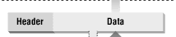
Networking Part 2
Data is transmitted using network packets
Packets contain headers
Headers tell networking appliances what to do with packets
Notes:
Why networking? Why do we care?

Slide 5
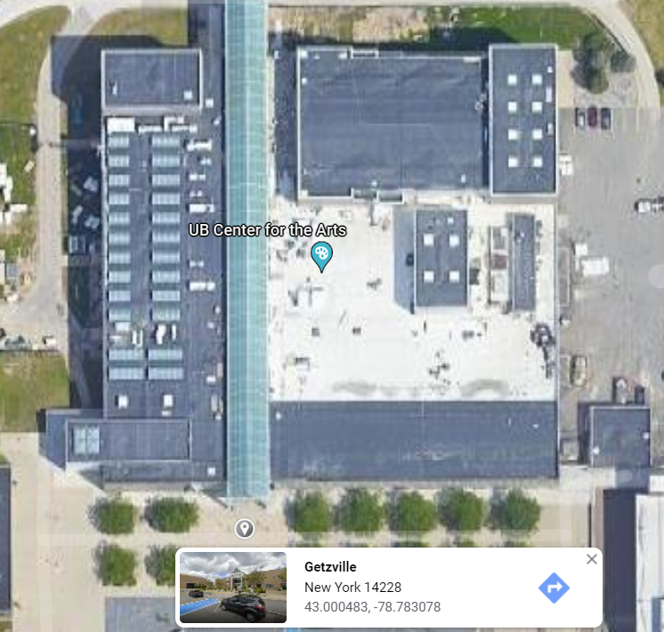
Intro to Ports
Recall MAC Addresses
Consider these similar to physical coordinates
Notes:
Why networking? Why do we care?

Slide 6
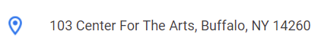
Intro to Ports
Recall IP Addresses
Consider these similar to postal addresses for buildings
Notes:
Why networking? Why do we care?

Slide 7
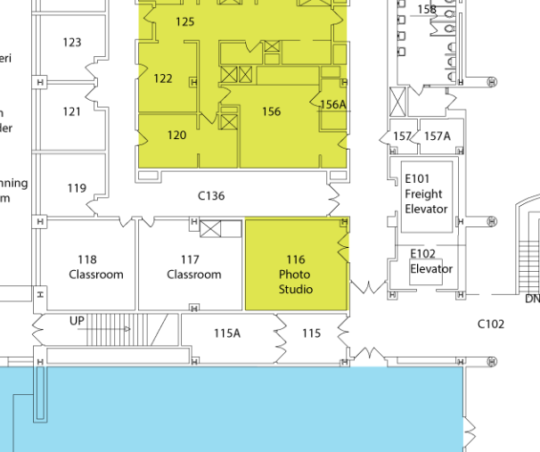
Intro to Ports
Ports are similar to room numbers
MAC: 43.000483, -78.783078
IP: 103 Center for the Arts
Port: Room 116
Ports are indicated next to IP addresses
192.168.15.152:116
Notes:
Why networking? Why do we care?

Slide 8
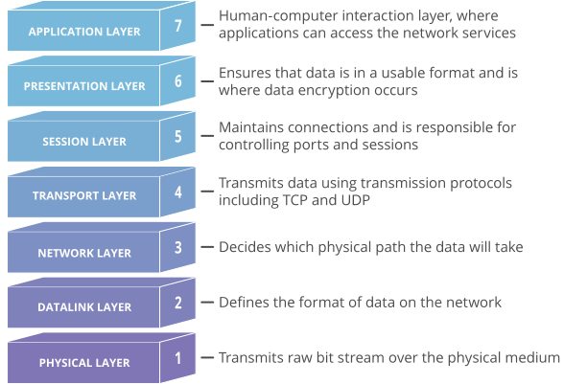
The Transport Layer
Ports are managed by the OSI network transport layer
The transport layer also manages packet exchange protocols
TCP
Downloading a File
UDP
Streaming or Video Call
ICMP
Notes:
Why networking? Why do we care?

Slide 9
In Class Activity
TCP/UDP Packet Polo

Slide 10
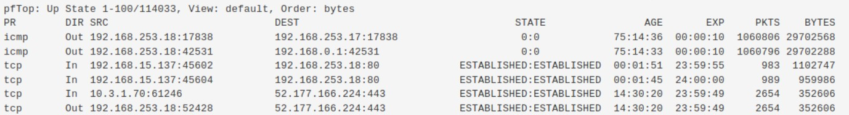
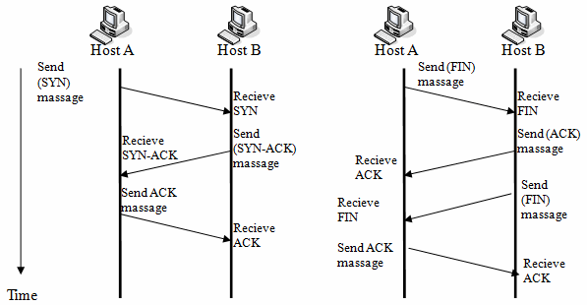
TCP Handshake
Notes:
Why networking? Why do we care?

Slide 11
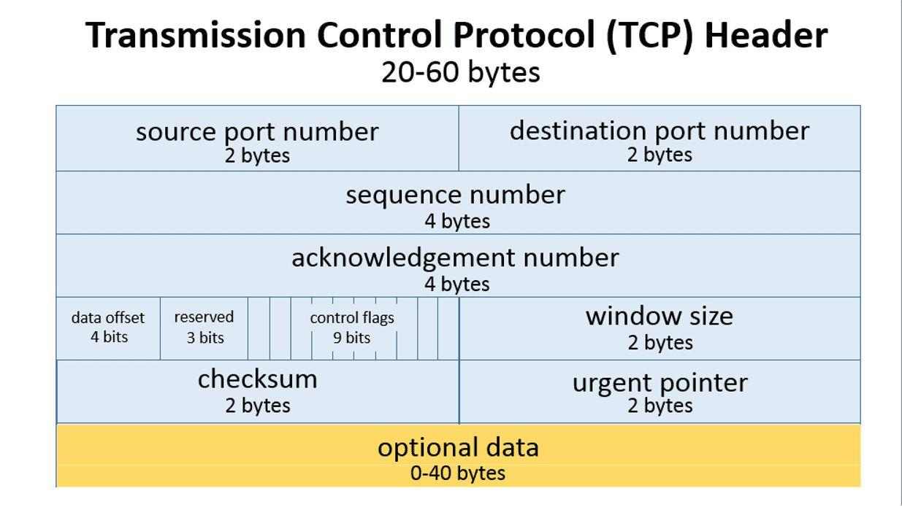
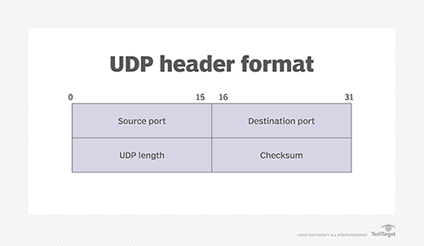
Activity Takeaways
TCP has sessions
UDP does not have sessions
TCP Header
UDP Header
Notes:
Why networking? Why do we care?

Slide 12
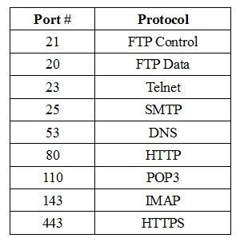
The Application Layer
“Application Layer”
The transport layer cannot do it all
For example:
Domain Name Service (DNS) Protocol
May require TCP or UDP protocols
Hypertext Transfer Protocol (HTTP)
Often requires two different devices
Common port numbers are assigned to popular application protocols
Notes:
Why networking? Why do we care?

Slide 13
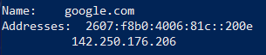
DNS
How does your computer get to www.Google.com?
A DNS server is used to translate a website name to and IP address
Notes:
Why networking? Why do we care?

Slide 14
DNS Demo
Open a CLI
nslookup washington.edu
Copy IP Address into web browser
You may need to use http:// as a URL prefix

Slide 15
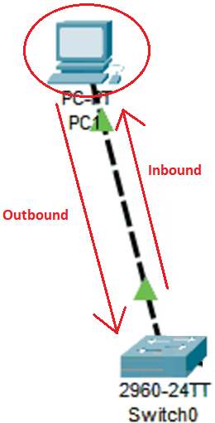
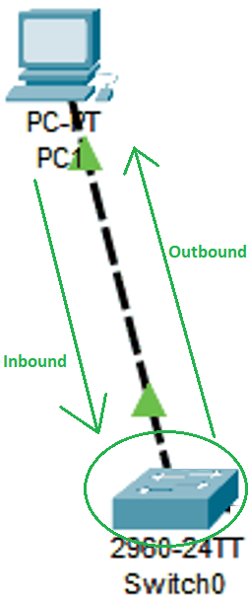
Directional Flow
Notes:
Why networking? Why do we care?

Slide 16
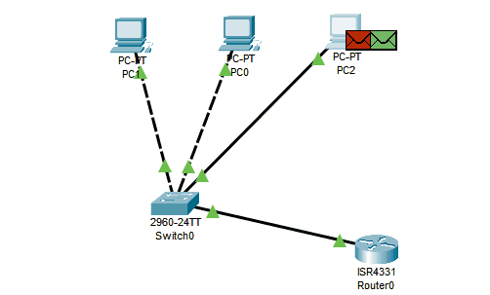
Data flows freely… for now
Notes:
Why networking? Why do we care?

Slide 17
Questions?

Slide 18
Break slide
Please return in 10 minutes

Slide 19
In Class Activity
Hands-on Migration

Slide 20
Activity – Migrate Windows to AdminNet
Migrate your Windows client from ServerNet to AdminNet.

Slide 21
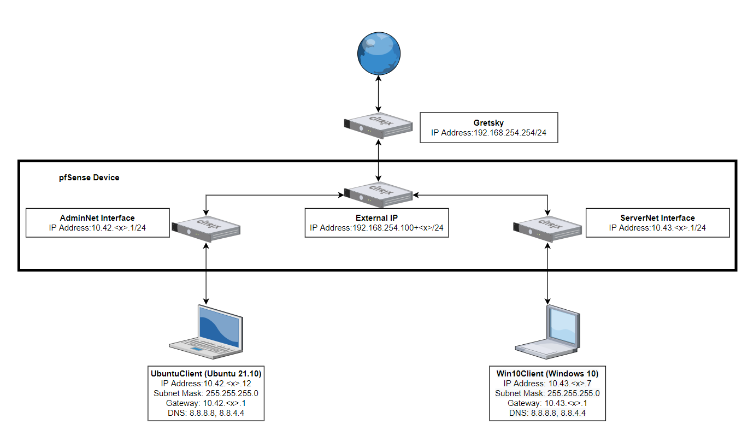
Activity – Migrate Windows to AdminNet
Before

Slide 22
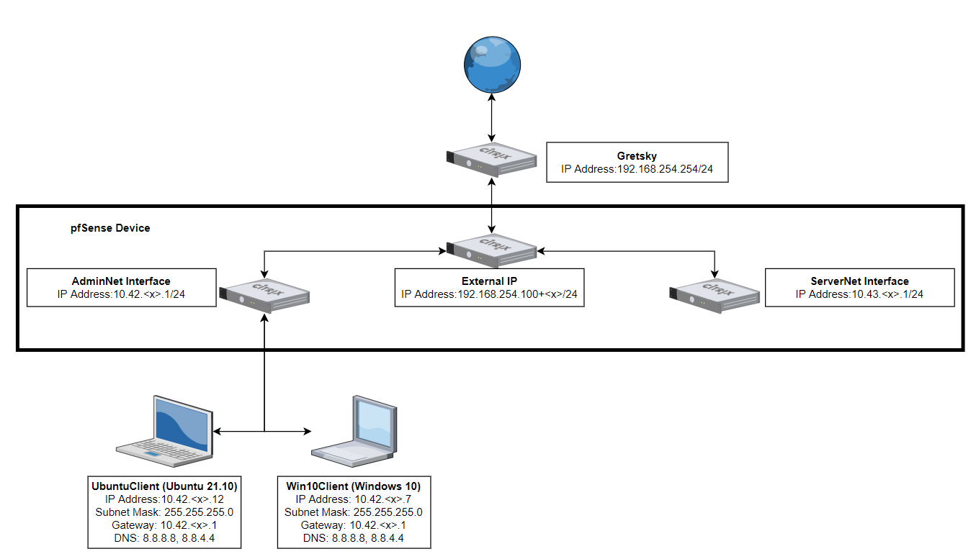
Activity – Migrate Windows to AdminNet
After

Slide 23
Why Firewalls?

Slide 24
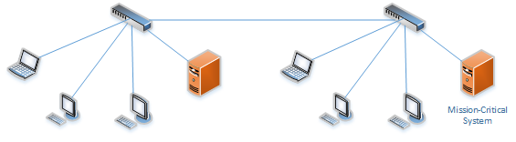
Any networked device can access the mission-critical system

Slide 25
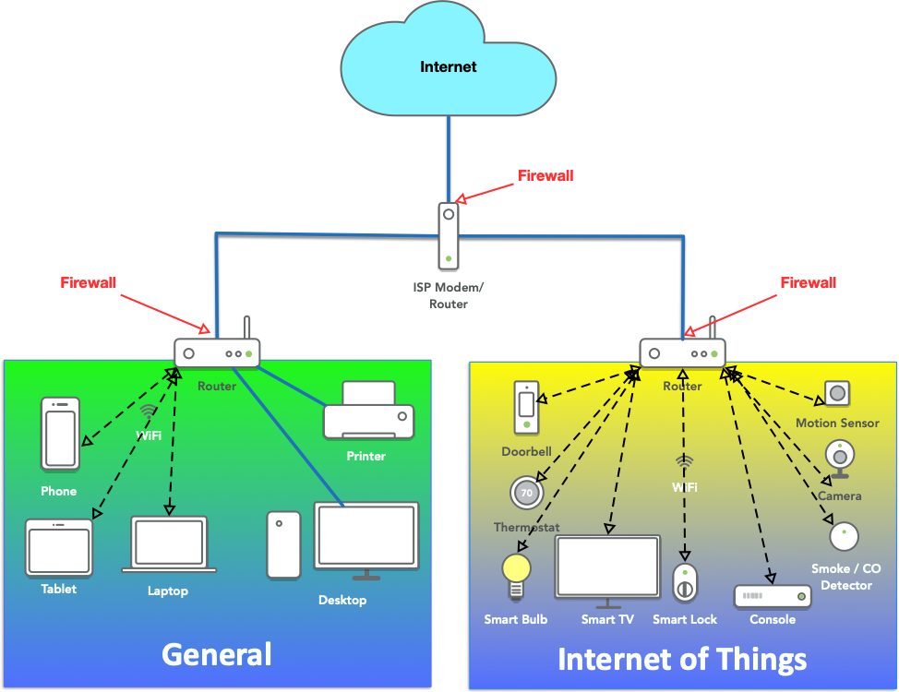

Slide 26
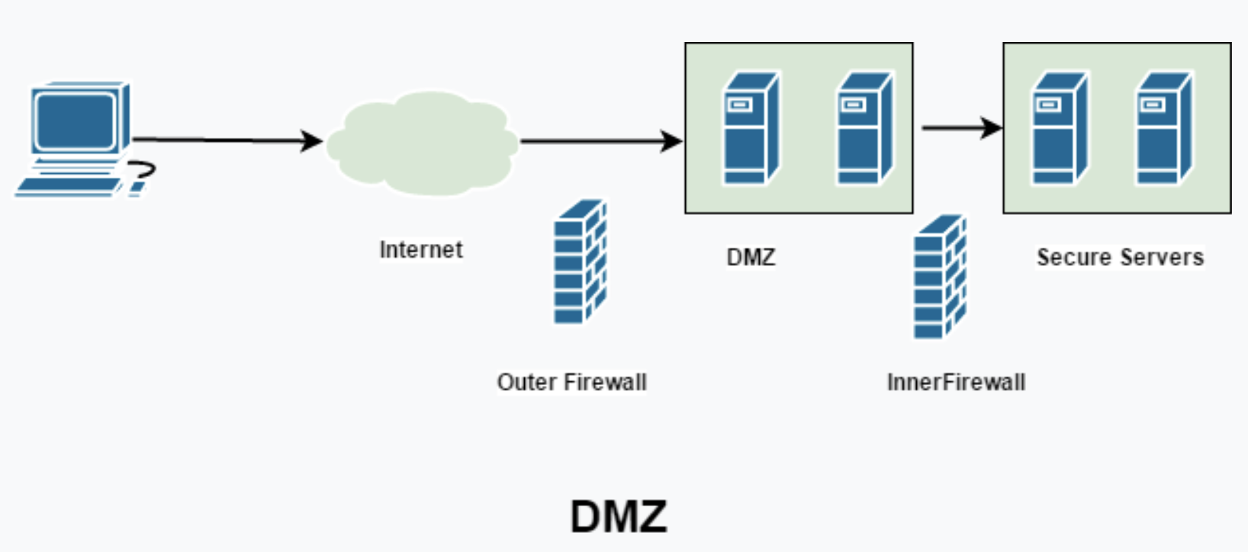

Slide 27
Types of Firewalls
Packet Filters (GEN 1)
Stateful Firewalls (GEN 2)
Host-Based
pfSense
Next-generation Firewalls (NGFW)
Palo Alto (coming soon in this class)
Notes:
Why networking? Why do we care?

Slide 28
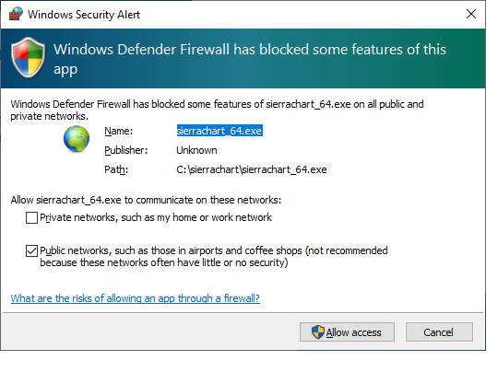
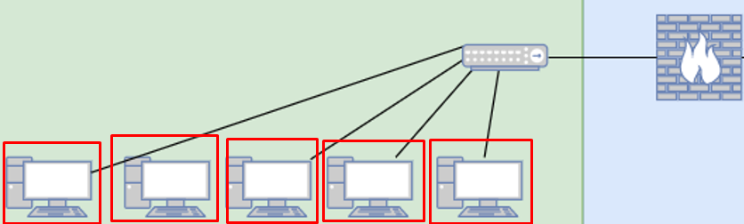
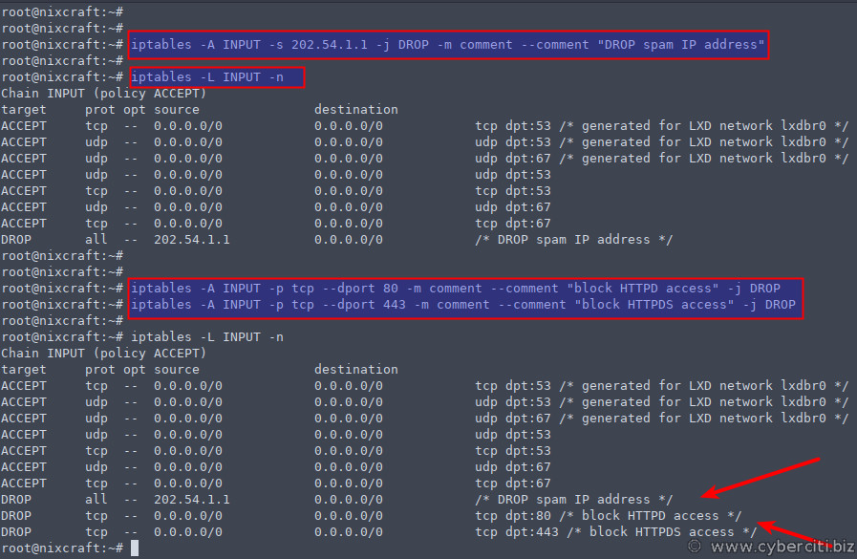
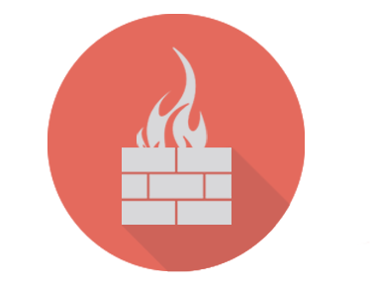
Host based Firewalls
Notes:
Why networking? Why do we care?

Slide 29
In Class Activity
TCP/UDP Packet Polo with Firewall

Slide 30
TCP/UDP Packet Polo with Firewall

Slide 31
In Class Activity
Login to pfSense

Slide 32
Current Network State

Slide 33
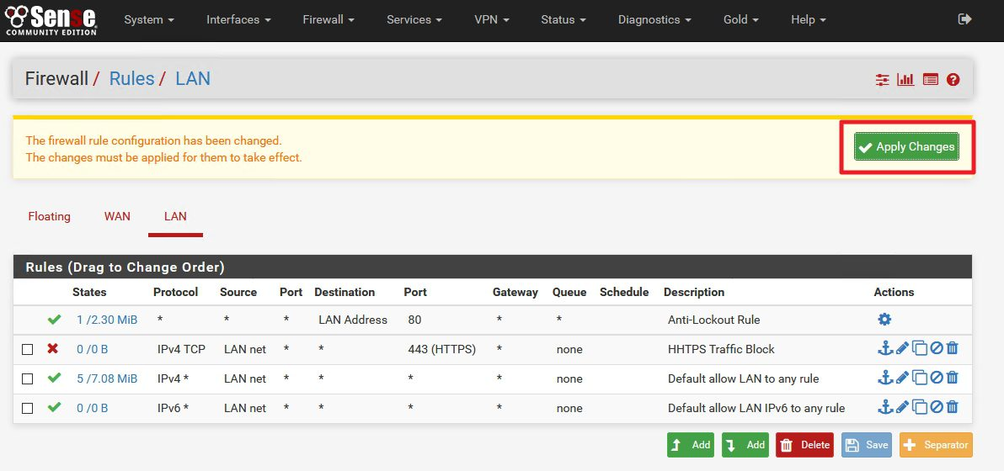
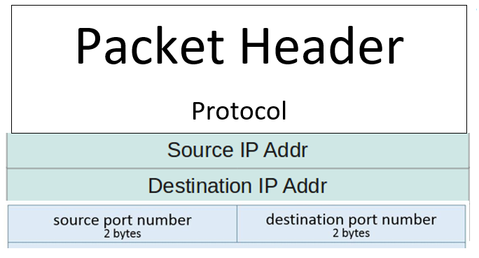
Header to Firewall
Notes:
Why networking? Why do we care?

Slide 34
Header to Firewall
Notes:
Why networking? Why do we care?

Slide 35
Header to Firewall
Notes:
Why networking? Why do we care?

Slide 36
Header to Firewall
Notes:
Why networking? Why do we care?

Slide 37
Header to Firewall
Notes:
Why networking? Why do we care?

Slide 38
Header to Firewall
Notes:
Why networking? Why do we care?

Slide 39
The Logic of Firewalls

Slide 40
Rule Hierarchy
Each packet is checked against rules.
Rules are enforced from top to bottom
Packets can be:
Rejected
Dropped
Allowed
Notes:
Why networking? Why do we care?

Slide 41
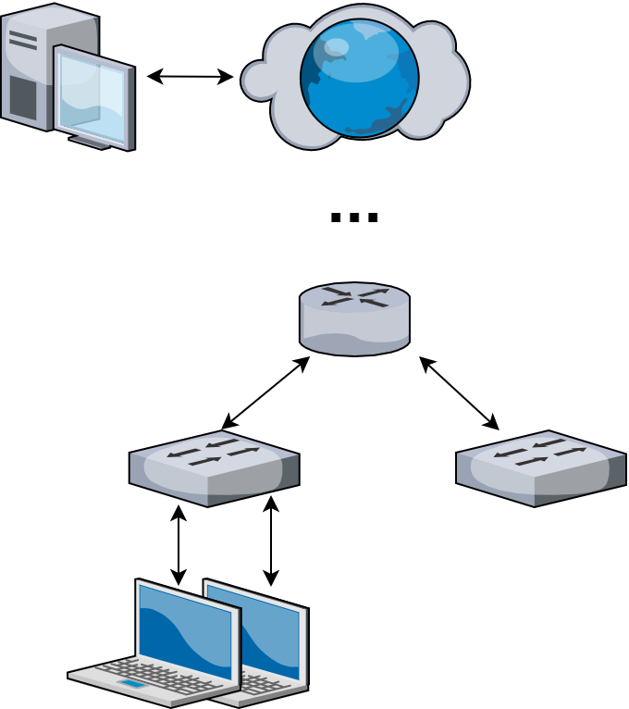
How Traffic Flows
Your Network

Slide 42
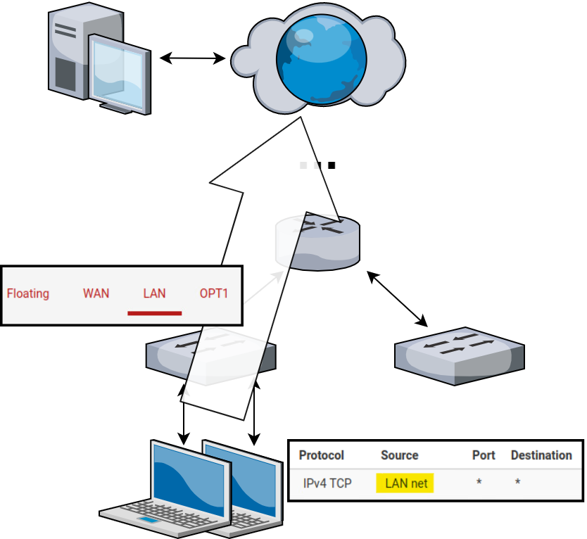
How Traffic Flows
From LAN (AdminNet) to Web

Slide 43
How Traffic Flows
Your Network

Slide 44
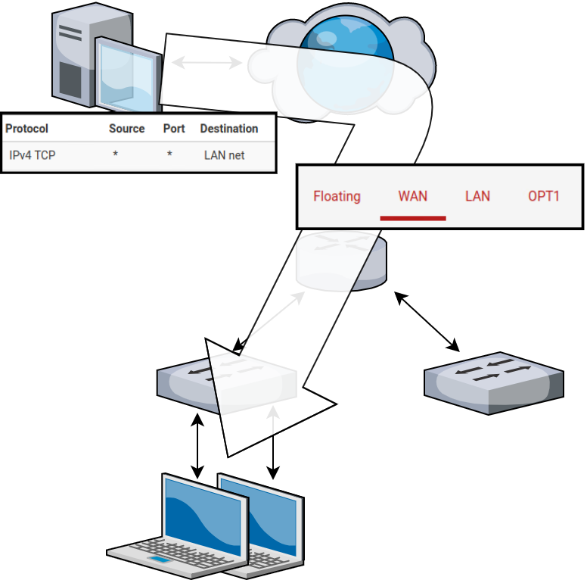
How Traffic Flows
From Web to LAN (AdminNet)
Web inbound is managed by the WAN (External) interface

Slide 45
Catch all rule
What if a packet doesn’t match any of our rules?
Notes:
Why networking? Why do we care?

Slide 46
Catch all rule
What if a packet doesn’t match any of our rules?
Firewalls use one or more default “catch all rule(s)” that is enforced when a packet does not match any listed rules.
The default behavior depends on firewall manufacturer
Notes:
Why networking? Why do we care?

Slide 47
Define Your Own Default Rule(s)
Default firewall rule(s) need to be at the bottom of the firewall’s rule list
Notes:
Why networking? Why do we care?

Slide 48
Logic of Firewalls Questions?

Slide 49
Compromised Device & pfSense Hands-On

Slide 50
Activity – pfSense Firewall
Prevent all ping requests from inside your LAN to anywhere on the WAN (Anywhere on internet)
Test by attempting to ping 8.8.8.8
If this is too easy
Make it so you can ping Gretzky (192.168.254.254) but not 8.8.8.8
Notes:
Why networking? Why do we care?

Slide 51
Activity – Compromised Windows 10 Host
Prevent me from being able to access your system.
Credentials:
Username: sysadmin
Password: Change.me!
Hint[0]: get-nettcpconnection
Hint[1]: What are the remote control protocols that Windows uses?
Notes:
Why networking? Why do we care?

Slide 52
Homework Prep

Slide 53
System Prep
Prep 1: Install SSH on your Linux client
Package name: openssh-server
sudo apt install openssh-server
https://youtu.be/HJXo68LnNOs
Prep 2: Run script from GitHub on Windows Client (PrepareWindowsSystem.ps1)
https://github.com/ubnetdef/WindowsScriptsForLecture
https://www.youtube.com/watch?v=Z6kNyfZiNxg
Notes:
Why networking? Why do we care?

Slide 54
Homework Starter

Slide 55
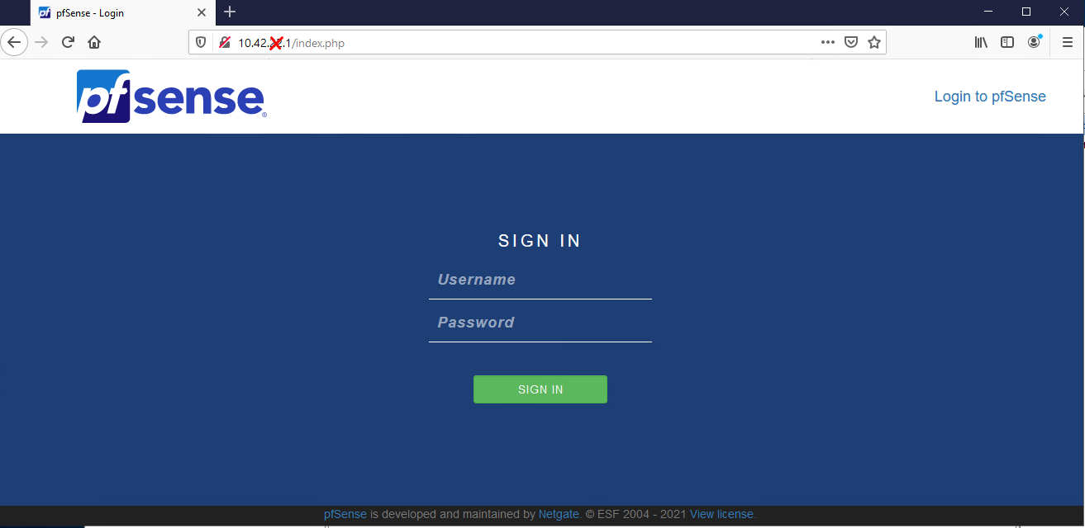
Homework Starter
Credentials
Username: admin
Password: pfsense
Notes:
Why networking? Why do we care?

Slide 56
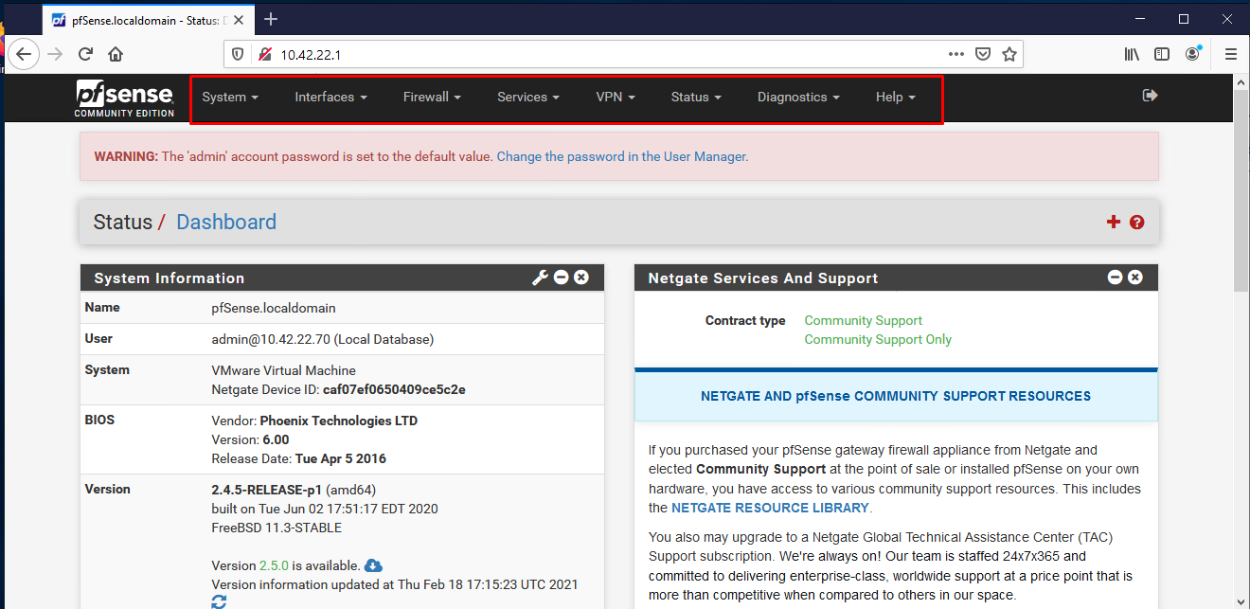
Homework Starter
Navigation through PFSense UI can generally be done using the top bar
Notes:
Why networking? Why do we care?

Slide 57
Homework Starter
Rules menu is under Firewall > Rules
Notes:
Why networking? Why do we care?

Slide 58
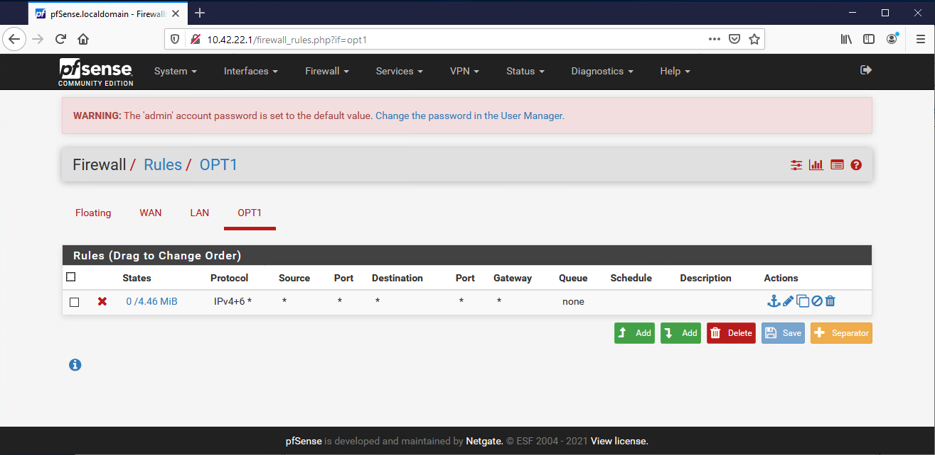
Homework Starter
Rules are grouped by the interface that handles the packets
Notes:
Why networking? Why do we care?

Slide 59
Homework Hint
If after you apply a firewall rule you can no longer connect to your pfsense router through the Web Interface it is likely you have a firewall rule that is blocking you. Use pfctl –d to disable the firewall and make sure to fix the offending rule before applying and additional rules.
Everytime you add a new rule and change it, it re-enables the firewall.
Notes:
Why networking? Why do we care?

